Slide 1
Unit 3: Boolean Expressions, if Statements
Compound Boolean Expressions and Comparing Objects
Adapted from:
1) Building Java Programs: A Back to Basics Approach
by Stuart Reges and Marty Stepp
2) Runestone CSAwesome Curriculum
https://longbaonguyen.github.io

Slide 2
Evaluating logic expressions
Sometimes it is useful to use nested if conditions: if statements within if statements.
// if x is odd
if(x % 2 != 0){
// if x is positive
if(x > 0){
…
}
}
We can combine the above nested if conditions using logical operators.

Slide 3
Logical operators
Tests can be combined using logical operators:
"Truth tables" for each, used with logical values p and q:
Operator | Description | Example | Result
&& | and | (2 == 3) && (-1 < 5) | false
|| | or | (2 == 3) || (-1 < 5) | true
! | not | !(2 == 3) | true
p | q | p && q | p || q
true | true | true | true
true | false | false | true
false | true | false | true
false | false | false | false
p | !p
true | false
false | true

Slide 4
Combining Tests
The following code
// if x is odd
if(x % 2 != 0){
// if x is positive
if(x > 0){
…
}
}
is equivalent to:
// if x is odd and positive
if(x % 2 != 0 && x > 0){
…
}

Slide 5
Using boolean
  boolean goodAge = age >= 12 && age < 29;
  boolean goodHeight = height >= 78 && height < 84;
  boolean rich = salary >= 100000.0;
  if ((goodAge && goodHeight) || rich) {
  System.out.println("Okay, let's go out!");
  } else {
  System.out.println("It's not you, it's me...");
  }

Slide 6
Evaluating logic expressions
Relational operators have lower precedence than math.
    5 * 7 >= 3 + 5 * (7 - 1)
    5 * 7 >= 3 + 5 * 6
    35 >= 3 + 30
    35 >= 33
    true
Relational operators cannot be "chained" as in algebra.
    2 <= x <= 10
    true <= 10 (assume that x is 15)
    error!
  Instead, combine multiple tests with && or ||
    2 <= x && x <= 10
    true && false
    false

Slide 7
Order of Operations
Precedence | Operator | Operation
highest | ** | exponentiation
 | - | negation
 | *, /, % | multiplication, division, modulo
 | +, - | adding, subtraction
 | ==,!=,<,>,<=,>= | comparisons(relationals)
 | not | logical not
 | and | logical and
 | or | logical or
lowest | = | assignment

Slide 8
Evaluating logic expressions
AND is evaluated before OR.
int x = 2;
int y = 4;
int z = 5;
    z > 2 || x > 3 && y < 3 ;
    // true if evaluate && before ||
    // false if evaluate || before &&
    // the correct answer is true: &&
    // MUST be evaluated before ||

Slide 9
Logical questions
What is the result of each of the following expressions?
  int x = 42;
  int y = 17;
  int z = 25;
  y < x && y <= z
  x % 2 == y % 2 || x % 2 == z % 2
  x <= y + z && x >= y + z
  !(x < y && x < z)
  (x + y) % 2 == 0 || !((z - y) % 2 == 0)
    Answers:
    - true
    - false
    - true
    - true
    - false

Slide 10
if/else with return
  // Returns the larger of the two given integers.
  public static int max(int a, int b) {
  if (a > b) {
  return a;
  } else {
  return b;
  }
  }
Methods can return different values using if/else
  Whichever path the code enters, it will return that value.
  Returning a value causes a method to immediately exit.
  All paths through the code must reach a return statement.

Slide 11
All paths must return
  public static int max(int a, int b) {
  if (a > b) {
  return a;
  }
  // Error: not all paths return a value
  }
The following also does not compile:
  public static int max(int a, int b) {
  if (a > b) {
  return a;
  } else if (b >= a) {
  return b;
  }
  }
  The compiler thinks if/else/if code might skip all paths, even though mathematically it must choose one or the other.

Slide 12
if/else, return question
Write a method quadrant that accepts a pair of real numbers x and y and returns the quadrant for that point:
  Example: quadrant(-4.2, 17.3) returns 2
    If the point falls directly on either axis, return 0.
y+
quadrant 2
quadrant 1
x-
x+
quadrant 3
quadrant 4
y-

Slide 13
if/else, return answer
  public static int quadrant(double x, double y) {
  if (x > 0 && y > 0) {
  return 1;
  } else if (x < 0 && y > 0) {
  return 2;
  } else if (x < 0 && y < 0) {
  return 3;
  } else if (x > 0 && y < 0) {
  return 4;
  } else { // at least one coordinate equals 0
  return 0;
  }
  }

Slide 14
De Morgan's Law
De Morgan's Law: Rules used to negate boolean tests.
  Useful when you want the opposite of an existing test.
  !(a && b) = !a || !b
  !(a || b) = !a && !b
  Example:
Original Code | Negated Code
if (x == 7 && y > 3) { ... } | if (x != 7 || y <= 3) { ... }

Slide 15
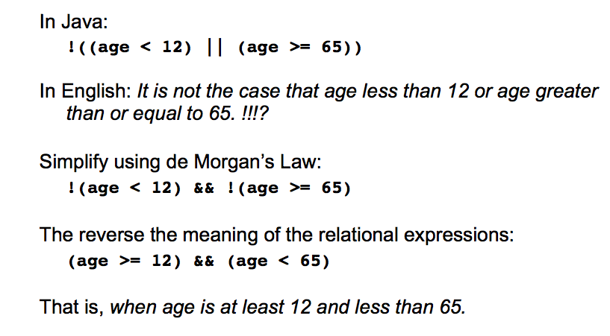
De Morgan’s Law

Slide 16
Truth Tables
Truth tables can be used to prove Boolean identities.
For example, use a truth table to prove:
  !(a && b) = !a || !b
  Since both expressions have the same values in all cases, they are equivalent.
a | b | !(a && b) | !a || !b
true | true | false | false
true | false | true | true
false | true | true | true
false | false | true | true

Slide 17
"Short-circuit" evaluation
Java stops evaluating a test if it knows the answer.
  && stops early if any part of the test is false
  || stops early if any part of the test is true
int count = <input from user>;
int sum = <input from user>;
if(count > 0 && (double)sum / count > 10){
System.out.println(“average > 10”);
}
else{
System.out.println(“count <= 0 or average <= 10);
}
If count = 0 above, there is a potential to divide by 0. However, short-circuit prevents this since count > 0 is false, it stops early and no division by zero was performed.

Slide 18
Boolean practice questions
Write a method named isVowel that returns whether a String is a vowel (a, e, i, o, or u). Assume all letters are lowercase.
  isVowel("q") returns false
  isVowel("a") returns true
  isVowel("e") returns true
  public static boolean isVowel(String s) {
  return s.equals("a") || s.equals("e") ||
  s.equals("i") || s.equals("o") ||
  s.equals("u");
  }

Slide 19
Boolean practice questions
Change the above method into an isNonVowel method that returns whether a String is any character except a vowel.
  isNonVowel("q") returns true
  isNonVowel("a") returns false
  isNonVowel("e") returns false
What’s the wrong strategy?
  // Enlightened "Boolean Zen" version
  public static boolean isNonVowel(String s) {
  return !s.equals("a") && !s.equals("e") &&
  !s.equals("i") && !s.equals("o") &&
  !s.equals("u");
  }

Slide 20
Boolean practice questions
Use isVowel to write isNonVowel.
  // Enlightened "Boolean Zen" version
  public static boolean isNonVowel(String s) {
  return !isVowel(s);
  }

Slide 21
Comparing Objects
Two objects are considered aliases when they both reference the
same object. Consider the Sprite class we discussed in Unit 2 used to
represent a game character.
public class Aliases
{
public static void main(String[] args){
Sprite player = new Sprite(30, 50);
Sprite another = player;
System.out.println(player == another); // true
}
}
Both object references player and another points to the same
address hence the same object in memory.
Notes:
// This program computes two people's body mass index (BMI) and
// compares them. The code uses parameters, returns, and Scanner.
import java.util.*; // so that I can use Scanner
public class BMI {
public static void main(String[] args) {
System.out.println("This program reads in data for two people and");
System.out.println("computes their body mass index (BMI)");
System.out.println();
// finish me!
}
}

Slide 22
Comparing Objects
Two different objects can have the same attributes/data.
public class Aliases2
{
public static void main(String[] args){
Sprite player = new Sprite(30, 50);
Sprite another = new Sprite(30, 50);
System.out.println(player == another); // false!
System.out.println(player != another); // true!
}
}
The references player and another above are two different Sprite
objects(created individually using new) but both are located at the
same coordinate.
Notes:
// This program computes two people's body mass index (BMI) and
// compares them. The code uses parameters, returns, and Scanner.
import java.util.*; // so that I can use Scanner
public class BMI {
public static void main(String[] args) {
System.out.println("This program reads in data for two people and");
System.out.println("computes their body mass index (BMI)");
System.out.println();
// finish me!
}
}

Slide 23
equals
Later in Unit 5 when we write our own objects, it will be useful to
implement the equals method for our class so check whether two
different objects are equivalent.
For example, consider Point objects with attributes x and y
representing points on the plane. Although the following two points are
distinct programmatically. They are equivalent mathematically. The
equals method will allow us to detect this. More on this later.
Point a = new Point(3,4);
Point b = new Point(3,4);
System.out.println(a == b); // false, different objects
System.out.println(a.equals(b)); // true
Notes:
// This program computes two people's body mass index (BMI) and
// compares them. The code uses parameters, returns, and Scanner.
import java.util.*; // so that I can use Scanner
public class BMI {
public static void main(String[] args) {
System.out.println("This program reads in data for two people and");
System.out.println("computes their body mass index (BMI)");
System.out.println();
// finish me!
}
}

Slide 24
References
For more tutorials/lecture notes in Java, Python, game programming, artificial intelligence with neural networks:
https://longbaonguyen.github.io
Building Java Programs: A Back to Basics Approach by Stuart Reges and Marty Stepp
2) Runestone CSAwesome Curriculum: https://runestone.academy/runestone/books/published/csawesome/index.html

